Slide 1
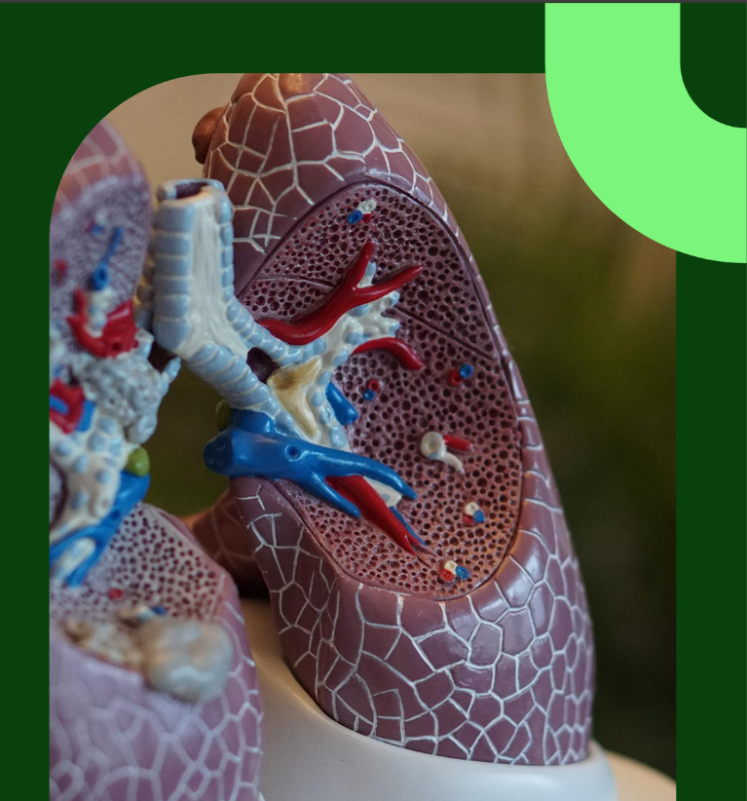
IMPACT OF ETHNICITY ON PREVALANCE OF LUNG DISEASES
ALOK SINGH (2100290100022)
DEVANSH VERMA(2100290100052)
DHRUV GUPTA(2100290100055)

Slide 2


Slide 3
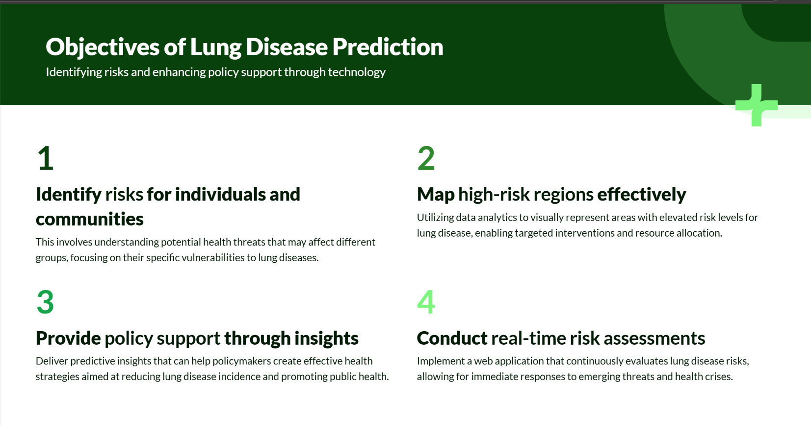

Slide 4
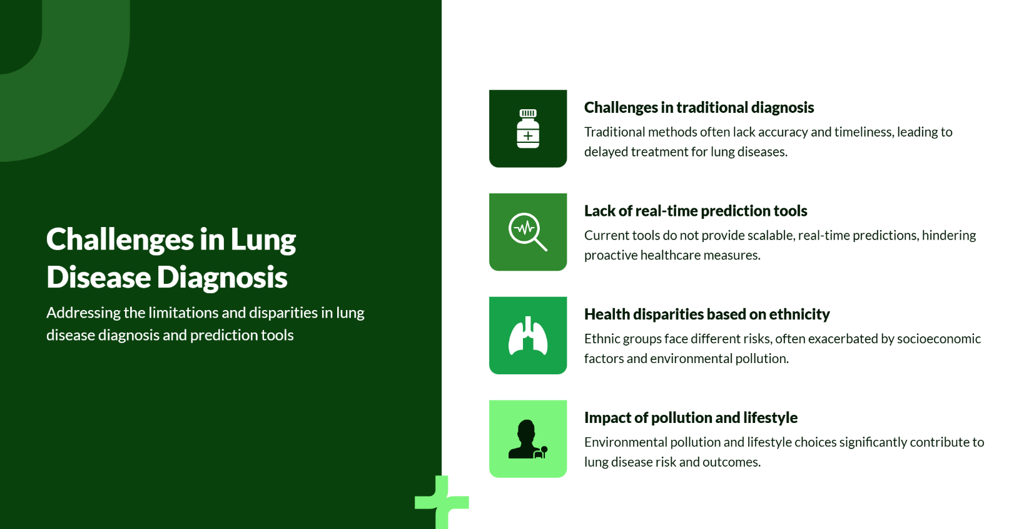

Slide 5
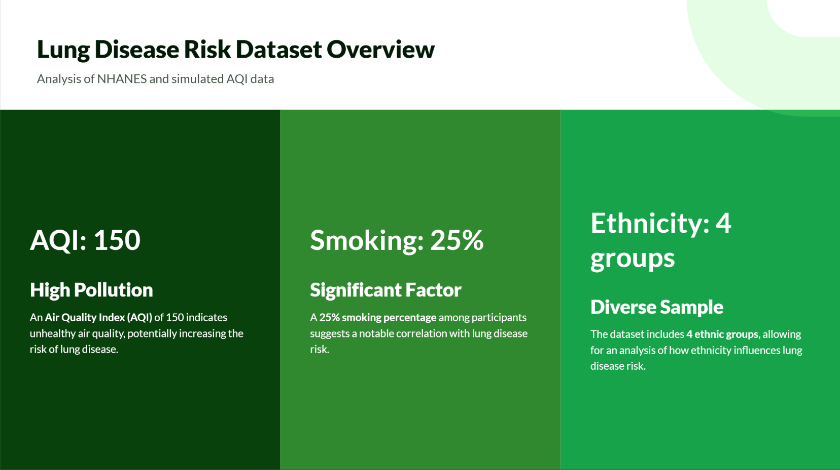

Slide 6
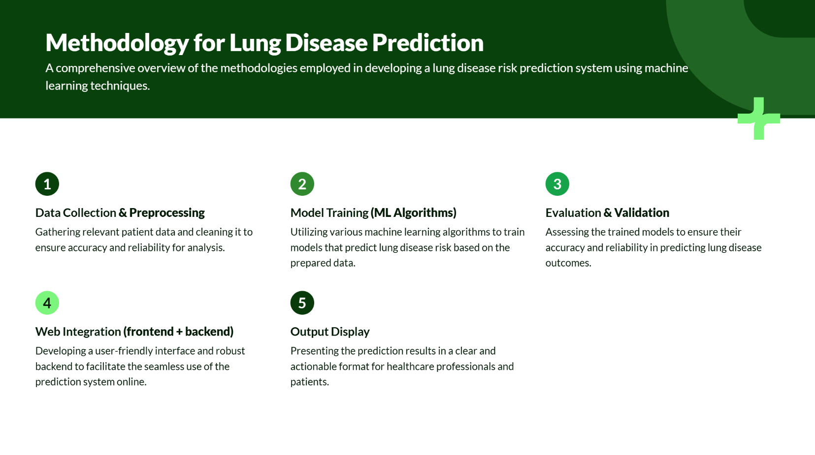

Slide 7
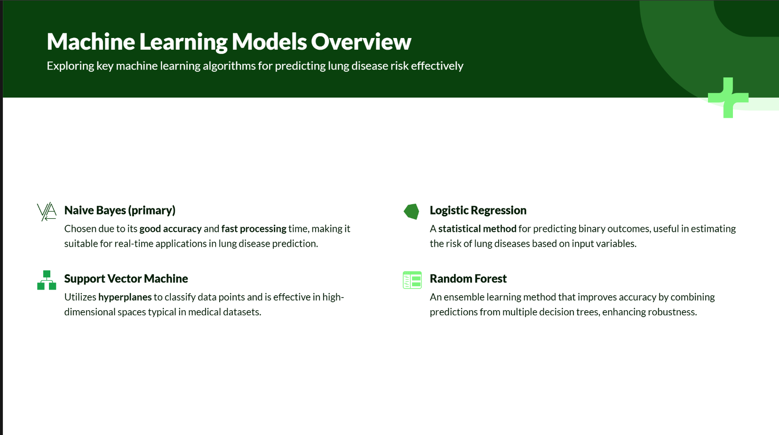

Slide 8


Slide 9
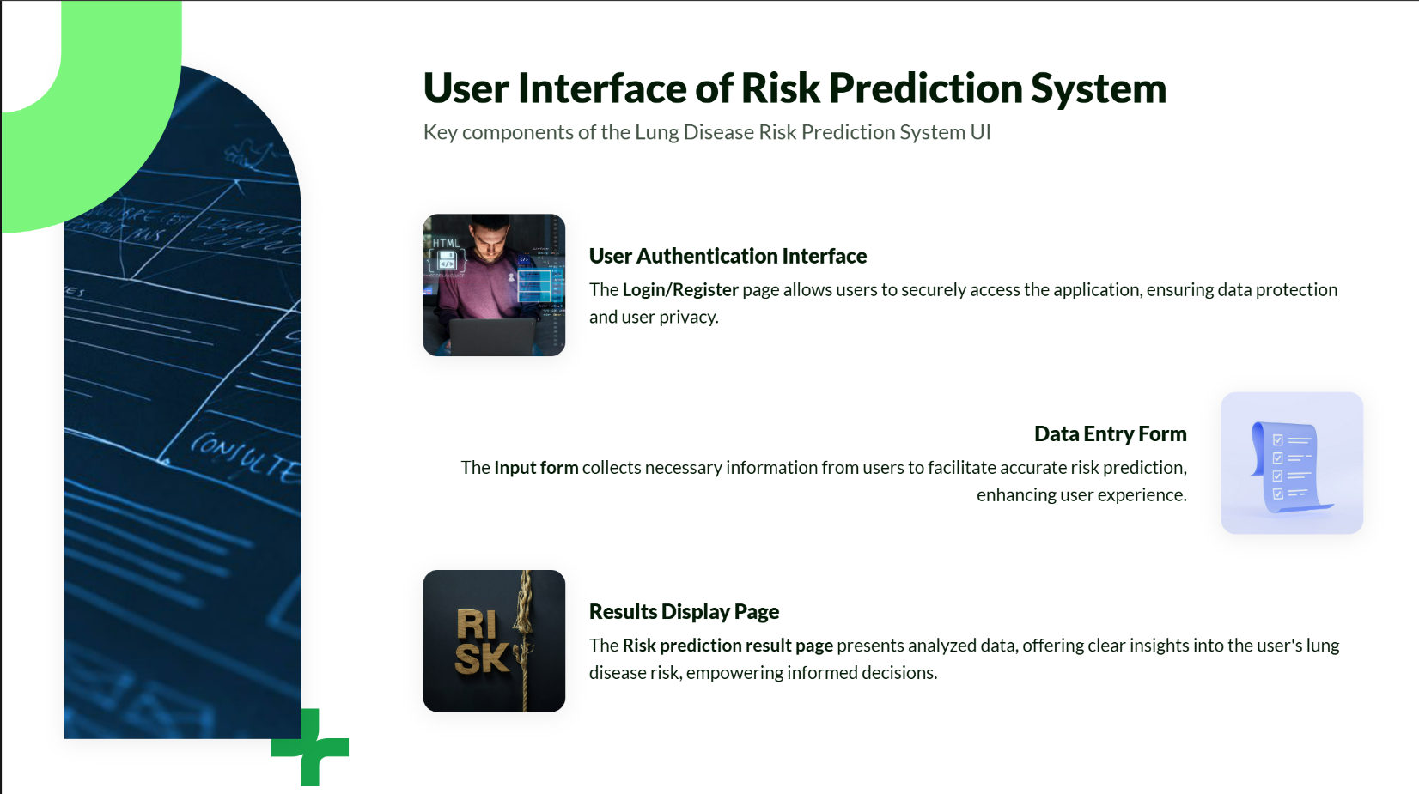

Slide 10
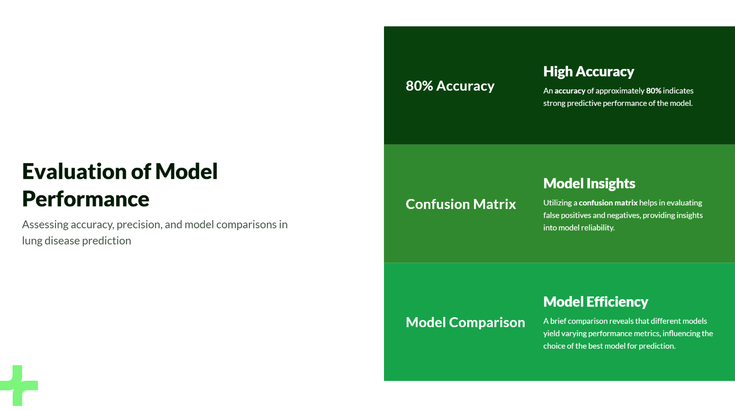

Slide 11
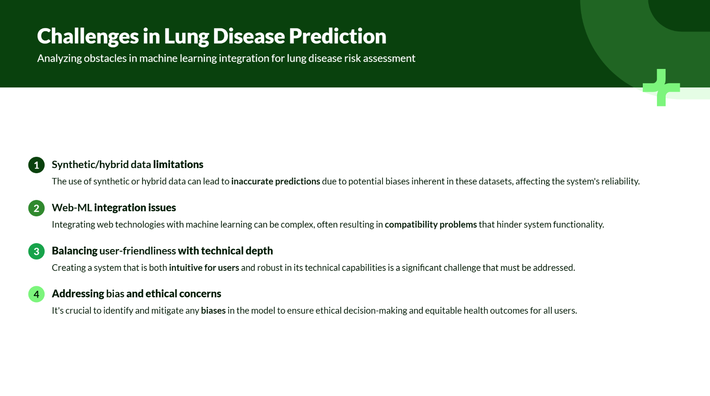

Slide 12
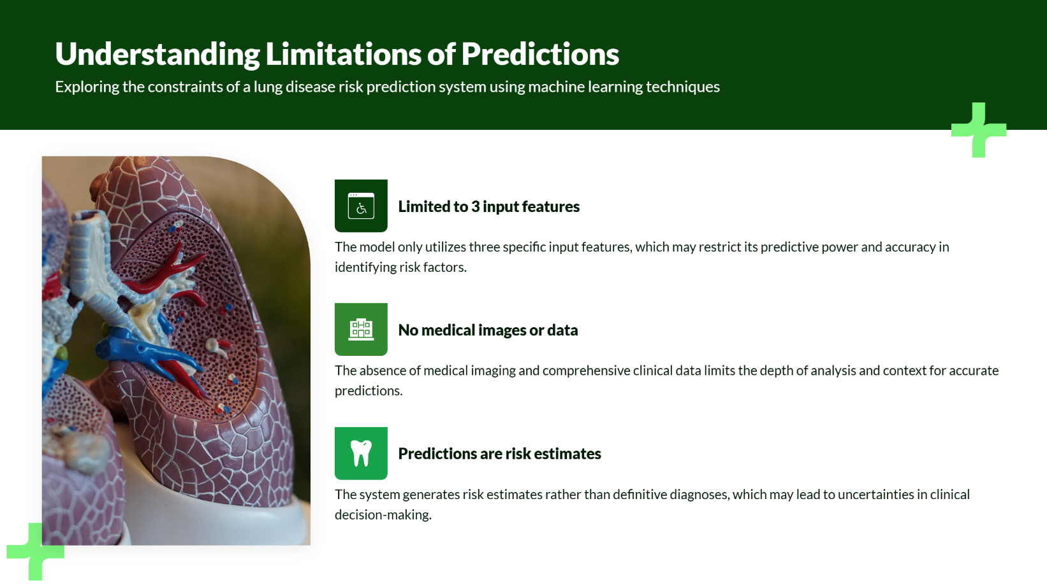

Slide 13


Slide 14


Slide 15
